Slide 1
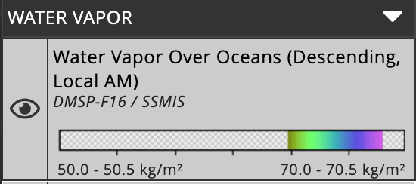
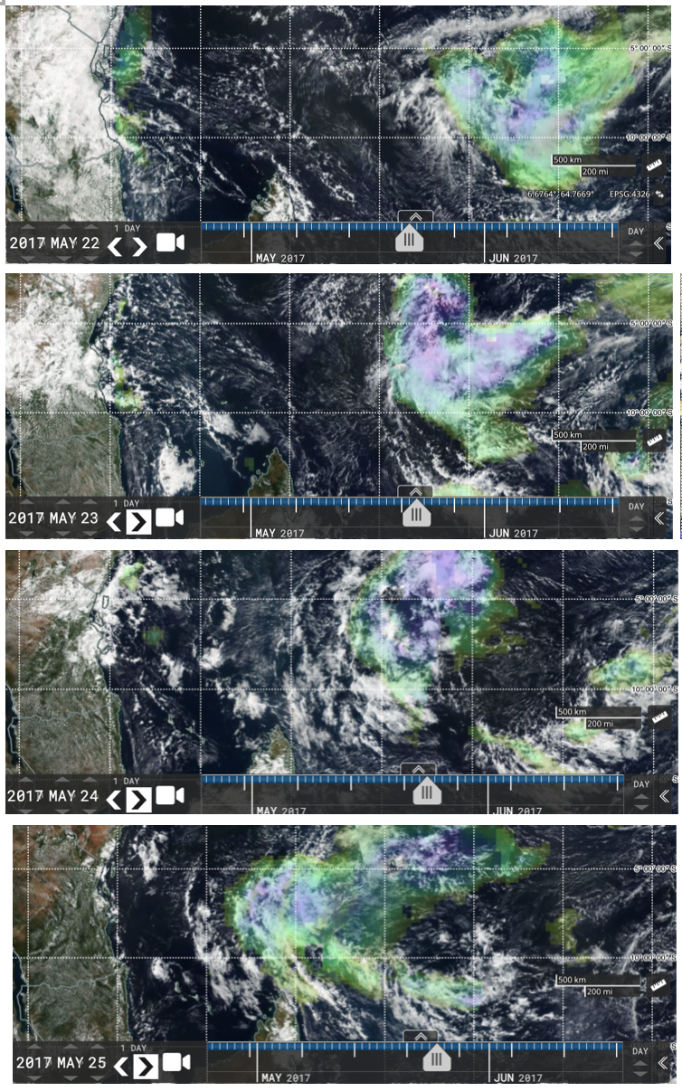
Water vapor ‘lakes’ over the tropical Indian ocean
Water vapor ‘lakes’ full of deep convective clouds can last many days, despite raining heavily. How can it work?
They landfall on eastern Africa’s water-limited coast, so it matters to people.
Brian Mapes, mapes@Miami.edu

